Slide 1

HEADING 1
HEADING 2
HEADING 3

Slide 2

EMOTIONAL INTELLIGENCE
HEADING 1
HEADING 2
HEADING 3
BRAINSTORMING
STARBURSTING
CHARETTE PROCEDURE
ROUND ROBIN BRAINSTORMING

Slide 3
EMOTIONAL INTELLIGENCE
HEADING 1
HEADING 2
HEADING 3
BRAINSTORMING
STAR BURSTING– What is it?
Questioning about problems
Evaluating ideas based on answers
Main six questions
What, Why, How, When, Who, and Which

Slide 4
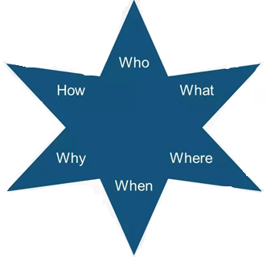
EMOTIONAL INTELLIGENCE
HEADING 1
HEADING 2
HEADING 3
STAR BURSTING
STAR Bursting method
Problem/Product in star’s centre
Six points of star – Six questions
Answer gives ideas for solution

Slide 5
EMOTIONAL INTELLIGENCE
HEADING 1
HEADING 2
HEADING 3
CHARETTE PROCEDURE
What is Charette procedure?
Oldest method to organize ideas
Larger group → Different smaller groups
Each group is assigned a topic

Slide 6
EMOTIONAL INTELLIGENCE
HEADING 1
HEADING 2
HEADING 3
CHARETTE PROCEDURE
How does it help?
Different topics to discuss
More audience
Limited time consumption
Developing existing ideas

Slide 7
EMOTIONAL INTELLIGENCE
HEADING 1
HEADING 2
HEADING 3
ROUND ROBIN BRAINSTORMING
What is Round robin brainstorming?
Iterative process of idea generation
Participation by all members
Suitable for small group

Slide 8
EMOTIONAL INTELLIGENCE
HEADING 1
HEADING 2
HEADING 3
ROUND ROBIN BRAINSTORMING
Process of Round robin brainstorming
Basic structure of round robin brainstorming:
Theme
Arrangement
Addition of points
Recurring process
Recording ideas

Slide 9
EMOTIONAL INTELLIGENCE
HEADING 1
HEADING 2
HEADING 3
SUMMARY
Star bursting method
Six questions
Charette procedure
Organizing ideas
Round robin brainstorming
Process of Round robin brainstorming

